Slide 1
Spring framework
by
Venkata Anil Kumar

Slide 2
Agenda
    Introduction
    Architecture
    Inversion of Control (IOC)
    AOP (Aspect Oriented programming)
    Spring DAO support and JDBC Support
    Transaction and Resource Management
    Spring ORM (Object Relational Mapping)
    Spring Web MVC Framework
    Web View Technologies
    Spring form and core tag libraries
    Integrating Spring with other technologies
    Spring Support for E-mail, PDF, Excel and Scheduling
    Spring remoting and Web services
    Spring Testing Support
    Conclusion

Slide 3
What is the Spring Framework?
Spring is a Lightweight Application Framework
A J2EE Framework designed to make building applications easier
Where Struts, Web Work, JSF and others can be considered Web frameworks, Spring addresses all tiers of an application,
Spring's goal is to be an entire Application framework. Struts and other popular frameworks are primarily Web frameworks.
Spring nicely integrates with most of the web frameworks including struts, tapestry, JSF, but it also provides an elegant MVC layer to replace these frameworks, if desired.

Slide 4
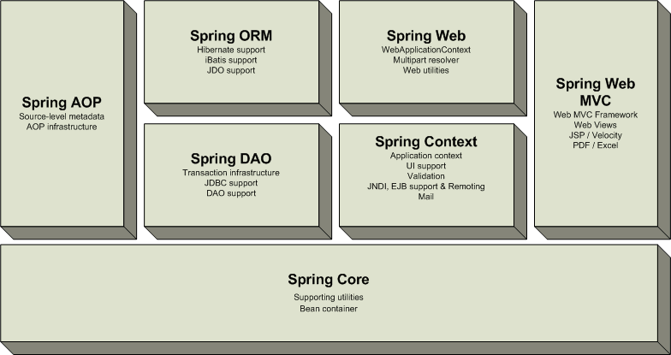
Spring Overview
Note: Spring distribution comes as one big jar file and alternatively as a series of smaller jars broken out along the above lines (so you can include only what you need)
Notes:
The Core package is the most fundamental part of the framework and provides the IoC and Dependency Injection features. The basic concept here is the BeanFactory,
which provides a sophisticated implementation of the factory pattern which removes the need for programmatic singletons and allows you to decouple the configuration
and specification of dependencies from your actual program logic.
The Context package build on the solid base provided by the Core package: it provides a way to access objects in a framework-style manner in a fashion somewhat
reminiscent of a JNDI-registry. The context package inherits its features from the beans package and adds support for internationalization (I18N) (using for example
resource bundles), event-propagation, resource-loading, and the transparent creation of contexts by, for example, a servlet container.
The DAO package provides a JDBC-abstraction layer that removes the need to do tedious JDBC coding and parsing of database-vendor specific error codes.
Also, the JDBC package provides a way to do programmatic as well as declarative transaction management, not only for classes implementing special interfaces,
but for all your POJOs (plain old Java objects).
The ORM package provides integration layers for popular object-relational mapping APIs, including JPA, JDO, Hibernate, and iBatis. Using the ORM package
you can use all those O/R-mappers in combination with all the other features Spring offers, such as the simple declarative transaction management feature
Spring's AOP package provides an AOP Alliance-compliant aspect-oriented programming implementation allowing you to define, for example, method-interceptors
and pointcuts to cleanly decouple code implementing functionality that should logically speaking be separated.
Spring's Web package provides basic web-oriented integration features, such as multipart file-upload functionality, the initialization of the IoC container
using servlet listeners and a web-oriented application context. When using Spring together with WebWork, JSF or Struts, this is the package to integrate with.
Spring's MVC package provides a Model-View-Controller (MVC) implementation for web-applications. Spring's MVC framework provides a clean separation between
domain model code and web forms, and allows you to use all the other features of the Spring Framework.

Slide 5
Inversion of Control (IOC)
Key to efficient Component Oriented Programming (COP).
Components don't look for resources, but simply declare what they need.
Inversion of Control (IOC) design principle, used by many modern containers to decouple dependencies between the components.
Dependency resolution and its life cycle management is handled by the container
Provides the efficient development process and Makes your application extremely testable
Eliminates lookup code within your application
Allows for pluggable and hot swapping and Enables reuse of existing code
Inversion of Control allows classes to be loosely coupled and dependencies written in XML
The term Inversion of Control (IOC) is also called Dependency Injection (DI).
Inversion of control follow the “Hollywood Principle”:
- Don’t call me, I’ll call you
Notes:
1-1.Using a Container to Manage Your Components
Problem
The basic idea of object-oriented design is to break your system into a group of reusable objects.
Without a central module to manage the objects, they have to create and manage their own dependencies. As a result, the objects are tightly coupled.
Solution
You need a container to manage the objects that make up your system. A container centralizes the creation of objects and acts as a registry to provide lookup services.
A container is also responsible for managing the life cycle of objects and providing a platform for the objects to run on.
Objects running inside a container are called components. They must conform to the specification defined by the container.

Slide 6
The beans
1. A Spring IoC container manages one or more beans. These beans are created using the configuration metadata that has been supplied to the container (typically in the form of XML <bean/> definitions).
<bean name=“abc” class=“com.sample.WidgetDAO”/>
2. Instantiating Beans: The beans can be instantiated using the following ways
a. Instantiation using constructor
<bean id="exampleBean" class="examples.ExampleBean"/>
b. Instantiation using static factory method.
<bean id="exampleBean“ class="examples.ExampleBean2“
factory-method="createInstance"/>
Using contructor-arg , we can pass parameters to the factory methos….
c. Instantiation using Instance factory method.
<!-- the factory bean, which contains a method called createInstance() -->
<bean id="serviceLocator" class="com.foo.DefaultServiceLocator">
<!-- inject any dependencies required by this locator bean -->
</bean>
<!-- the bean to be created via the factory bean -->
<bean id="exampleBean“ factory-bean="serviceLocator”
factory-method="createInstance"/>
Notes:
Instantiation using an instance factory method
In a fashion similar to instantiation via a static factory method, instantiation using an instance factory method is where a non-static method of an existing bean from the container is invoked
to create a new bean.
To use this mechanism, the 'class' attribute must be left empty, and the 'factory-bean' attribute must specify the name of a bean in the current (or parent/ancestor) container
that contains the instance method that is to be invoked to create the object. The name of the factory method itself must be set using the 'factory-method' attribute

Slide 7
Dependencies
Typically your application is not made up of a single object. Dependencies can exists between the objects.
It is the job of the container to actually inject those dependencies when it creates the bean. This is fundamentally the inverse, hence the name Inversion of Control (IoC),
Spring specifies 3 types of dependency injection (DI)/ Invesion of control (IOC) techniques between the dependent objects.
1. Constructor based Injection
2. Setter based Injection
3. Method based Injection

Slide 8
Constructor based dependency injection

Slide 9
Constructor based dependency injection
E.g 1
<bean id="movieFinder" class="com.samples.base.injections.constructor.MovieFinder" />
<bean id="simpleMovieListener" class="com.samples.base.injections.constructor.SimpleMoveListener" >
<constructor-arg>
<ref bean="movieFinder"/>
</constructor-arg>
<constructor-arg>
10
</constructor-arg>
<property name=“no” value=“5”/>
</bean>
public class SimpleMoveListener {
private MovieFinder movieFinder;
private int no; //setter methods
private int no1; //setter methods
public SimpleMoveListener (MovieFinder movieFinder, int no1) {
this.movieFinder = movieFinder;
this.no1 = no1;
}
}

Slide 10
Setter based dependency injection

Slide 11
Setter based dependency injection
Setter-based DI is realized by calling setter methods on your beans after invoking a no-argument constructor or no-argument static factory method to instantiate your bean.
E.g 1:
<bean id="movieFinder" class="com.samples.base.injections.constructor.MovieFinder" />
<bean id="simpleMovieListener" class="com.samples.base.injections.constructor.SimpleMoveListener" >
<property name=“movieFinder” ref="movieFinder“/>
</bean>
public class SimpleMoveListener {
private MovieFinder movieFinder;
public SimpleMoveListener () {
}
public setMovieFinder (MovieFinder movieFinder) {
this.movieFinder = movieFinder;
}
}

Slide 12
Using Collections as properties
public class CollectionInjection {
private Map mapObj;
private Properties propsObj;
private Set setObj;
private List listObj;
…….
}
<property name="mapObj"> <property name="setObj">
<map> <set>
<entry key="someValue"> <value>Hello World</value>
<value>Hello World!</value> <ref bean=“oracle”/>
</entry> </set>
<entry key="someBean"> </property>
<ref bean="oracle"/>
</entry> <property name=“listObj">
</map> <list>
</property> <value>Hello World</value> <ref bean=“oracle”/>
<property name="propsObj"> </list>
<props> </property>
<prop key="firstName"> Rob </prop>
<prop key="secondName"> Harrop </prop>
</props>
</property>

Slide 13
Using depends-on
1. The 'depends-on' attribute at the bean definition level is used not only to specify an initialization time dependency, but also to specify the corresponding destroy time dependency.
Dependent beans that define a 'depends-on' relationship with a given bean will be destroyed first - prior to the given bean itself being destroyed. As a consequence, 'depends-on' may be used to control shutdown order too.
<bean id="beanOne" class="ExampleBean"
depends-on="manager,accountDao">
<property name="manager" ref="manager" />
<property name=“accountDAO" ref=" accountDao " />
</bean>
<bean id="manager" class="ManagerBean" />
<bean id="accountDao" class="x.y.jdbc.JdbcAccountDao" />

Slide 14
Lazy initialization (lazy-init)
1. When configuring beans via XML, this lazy loading is controlled by the 'lazy-init' attribute on the <bean/> element; for example:
<bean id="lazyBean" class="com.foo.ExpensiveToCreateBean" lazy-init="true"/>
<bean name="notLazyBean" class="com.foo.AnotherBean"/>
When the above configuration is consumed by an ApplicationContext, the bean named 'lazyBean' will not be eagerly pre-instantiated when the ApplicationContext is starting up, whereas the 'notLazyBean' bean will be
eagerly pre-instantiated.
2. It is also possible to control lazy-initialization at the container level by using the 'default-lazy-init‘ attribute on the <beans/> element; for example:
<beans default-lazy-init="true">
<!-- no beans will be pre-instantiated... -->
……………………….
</beans>

Slide 15
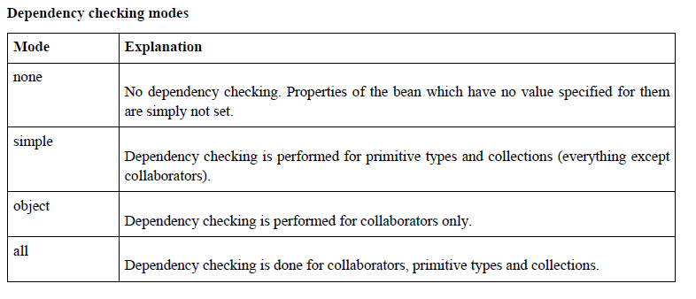
Checking for dependencies (dependency-check)
This feature is sometimes useful when you want to ensure that all properties (or all properties of a certain type) are set on a bean.
2. Dependency checking can be handled in several different modes. When using XML-based configuration metadata, this is specified via the 'dependency-check' attribute in a bean definition, which may have following rules.

Slide 16
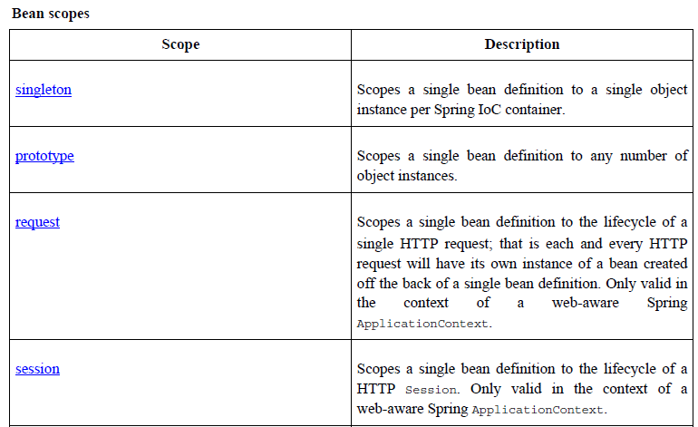
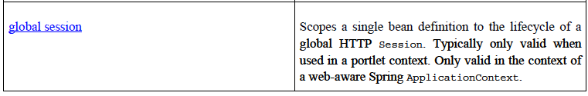
Bean Scopes (using scope)
Spring supports 5 types of bean scopes

Slide 17
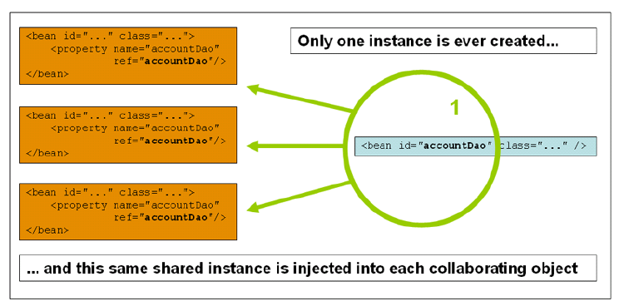
Bean Scopes (using scope)
The singleton scope
When a bean is a singleton, only one shared instance of the bean will be created and managed, and all requests for beans with an id or ids matching that bean definition will result in that one specific bean instance being returned by the Spring container.

Slide 18
Bean Scopes (using scope)
The singleton scope
<bean id="accountService" class="com.foo.DefaultAccountService"/>
<!-- the following is equivalent, though redundant (singleton scope is the default); using spring-beans-2.0.dtd -->
<bean id="accountService" class="com.foo.DefaultAccountService" scope="singleton"/>
<!-- the following is equivalent and preserved for backward compatibility in spring-beans.dtd -->
<bean id="accountService" class="com.foo.DefaultAccountService" singleton="true"/>
Notes:
<bean id="accountService" class="com.foo.DefaultAccountService"/>
<!-- the following is equivalent, though redundant (singleton scope is the default); using spring-beans-2.0.dtd -->
<bean id="accountService" class="com.foo.DefaultAccountService" scope="singleton"/>
<!-- the following is equivalent and preserved for backward compatibility in spring-beans.dtd -->
<bean id="accountService" class="com.foo.DefaultAccountService" singleton="true"/>

Slide 19
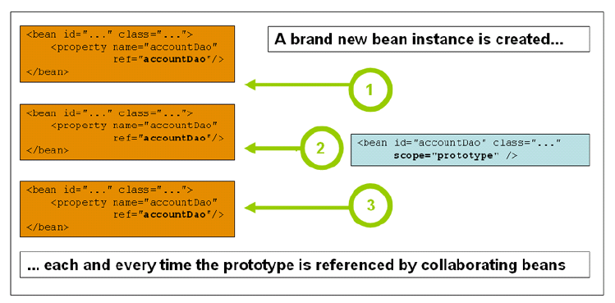
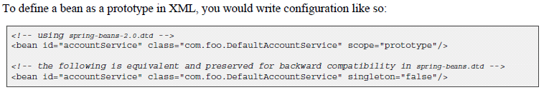
The prototype scope
The non-singleton, prototype scope of bean deployment results in the creation of a new bean instance every time a request for that specific bean is made

Slide 20
The Other scopes
The other scopes, namely request, session, and global session are for use only in web-based applications.
Request Scope:
The spring container creates a brand new instance of the bean for each and every Http Request.
Session Scope:
The spring container creates a brand new instance of the bean for the life time of a single HTTP session.
Global session scope.
The global session scope is similar to the standard HTTP Session scope, and
really only makes sense in the context of portlet-based web applications. Beans defined at the global session scope are scoped (or bound) to the lifetime of the global portlet Session.

Slide 21
Auto wiring (autowire)
The Spring container is able to autowire relationships between collaborating beans. This means that it is possible to automatically let Spring resolve collaborators (other beans) for your bean by inspecting the contents
of the BeanFactory.
The autowiring functionality has five modes
1. No
2. byName
3. byType
4. constructor
5. autodetect
No:
No autowiring at all. Bean references must be defined via a ref element. This is the default

Slide 22
Auto wiring
byName:
Autowiring by property name. This option will inspect the container and look for a bean named exactly the same as the property which needs to be autowired.
For example, if you have a bean definition which is set to autowire by name, and it contains a master property (that is, it has a setMaster(..) method), Spring will look for a bean definition named master, and use it to set the property.
<bean name=“master” class=“com.samples.Master”/>
<bean name=“sample1” class=“com.samples.Sample”>
<property name=“master” ref=“master”/>
</bean>
<bean name=“sample” auto-wire=“byName” class=“com.samples.Sample”>
</bean>
Class Sample {
private Master master;
private Master master1;
public void setMaster(Master master) {
this.master = master;
}
}

Slide 23
Auto wiring
byType:
Allows a property to be autowired if there is exactly one bean of the property type in the container. If there is more than one, a fatal exception is thrown, and this indicates that you may not use byType autowiring for that bean. If there are no matching beans, nothing happens; the property is not set.
<bean name=“master” class=“com.samples.Master”/>
<bean name=“sample” auto-wire=“byType” class=“com.samples.Sample”>
</bean>
Class Sample {
private Master master;
private Master master1;
Private Student student;
public void setMaster(Master master) {
this.master = master;
}
public void setMaster1(Master master1) {
this.master1 = master1;
}
}

Slide 24
Auto wiring
Constructor:
This is analogous to byName, but applies to constructor arguments. If there isn't exactly one bean of the constructor argument type in the container, a fatal error is raised.
Autodetect:
Chooses constructor or byType through introspection of the bean class. If a default constructor is found, the byType mode will be applied.

Slide 25
Bean Life Cycle and Call back methods

Slide 26
Bean Life cycle Call backs
The Spring Framework provides several callback interfaces to change the behavior of your bean in the container; they include InitializingBean and DisposableBean.
Implementing these interfaces will result in the container calling afterPropertiesSet() for the former and destroy() for the latter to allow the bean to perform certain actions upon initialization and destruction.
Initialization callbacks
Implementing the org.springframework.beans.factory.InitializingBean interface allows a bean to perform initialization work after all necessary properties on the bean have been set by the container.
The InitializingBean interface specifies exactly one method:
void afterPropertiesSet() throws Exception;
3. Generally, the use of the InitializingBean interface can be avoided and is actually discouraged since it unnecessarily couples the code to Spring. As an alternative, bean definitions provide support for a generic initialization method to be specified. In the case of XML-based configuration metadata, this is done using the 'init-method' attribute. For example, the following definition:

Slide 27
<bean id="exampleInitBean" class="examples.ExampleBean" init-method="init"/>
public class ExampleBean {
public void init() {
// do some initialization work
}
}
...is exactly the same as...
<bean id="exampleInitBean" class="examples.AnotherExampleBean"/>
public class AnotherExampleBean implements InitializingBean {
public void afterPropertiesSet() {
// do some initialization work
}
}
... but does not couple the code to Spring.

Slide 28
Destruction callbacks
Implementing the org.springframework.beans.factory.DisposableBean interface allows a bean to get a callback when the container containing it is destroyed.
The DisposableBean interface specifies a single method:
void destroy() throws Exception;
Generally, the use of the DisposableBean callback interface can be avoided and is actually discouraged since it unnecessarily couples the code to Spring.
For example, the following definition:
<bean id="exampleInitBean" class="examples.ExampleBean"
destroy-method="cleanup"/>
public class ExampleBean {
public void cleanup() {
// do some destruction work (like releasing pooled connections)
}
}
...is exactly the same as...
<bean id="exampleInitBean" class="examples.AnotherExampleBean"/>
public class AnotherExampleBean implements DisposableBean {
public void destroy() {
// do some destruction work (like releasing pooled connections)
}
}

Slide 29
Default Initialization and Destroy callback methods
<beans default-init-method="init">
<bean id="blogService" class="com.foo.DefaultBlogService">
<property name="blogDao" ref="blogDao" />
</bean>
</beans>
1. Notice the use of the 'default-init-method' attribute on the top-level <beans/> element. The presence of this attribute means that the Spring IoC container will recognize a method called 'init' on all the beans as being the initialization method callback
2. Destroy method callbacks are configured similarly (in XML that is) using the 'default-destroy-method‘ attribute on the top-level <beans/> element.
3. The use of this feature can save you the (small) housekeeping chore of specifying an initialization and destroy method callback on each and every bean, and it is great for enforcing a consistent naming convention for
initialization and destroy method callbacks

Slide 30
ApplicationContext
The Bean Factory package provides the basic functionality for managing and manipulating beans
The Application Context interface provides all functionalities provided by the BeanFactory and also it will provide the following functionality.
    MessageSource, providing access to messages in i18n-style.
    Access to resources, such as URLs and files.
    Event propagation to beans implementing the ApplicationListener interface.
    Loading of multiple (hierarchical) contexts, allowing each to be focused on one particular layer, for example the web layer of an application
The ApplicationContext interface provides the 3 context types .
    ClassPathXmlApplicationContext
    FileSystemXmlApplicationContext
    XmlWebApplicationContext
Continued…

Slide 31
ClassPathXMLApplicationContext
  It Loads context definition from an XML file located in the classpath, treating context definitions as classpath resources.
  The application context is loaded from the application's classpath by using the code
  ApplicationContext context = new ClassPathXmlApplicationContext("bean.xml");

Slide 32
FileSystemXmlApplicationContext
  It loads context definition from an XML file in the filesystem
  The application context is loaded from the file system by using the code
  ApplicationContext context = new FileSystemXmlApplicationContext("bean.xml");

Slide 33
XmlWebApplicationContext
  It loads context definition from an XML file contained within a web application.
  The application context is loaded from the web application by using the code
  ApplicationContext context = new XmlWebApplicationContext(“/WEB-INF/bean.xml");

Slide 34
Bean Post Processors
The BeanPostProcessor interface defines callback methods that you can implement to provide your own instantiation logic, dependency-resolution logic etc. You can also implement some custom logic after the Spring container finishes instantiating, configuring, and initializing a bean by plugging in one or more BeanPostProcessor implementations.
You can configure multiple BeanPostProcessor interfaces and you can control the order in which these BeanPostProcessor interfaces execute by setting the order property provided the BeanPostProcessor implements the Ordered interface.
The BeanPostProcessors operate on bean (or object) instances which means that the Spring IoC container instantiates a bean instance and then BeanPostProcessor interfaces do their work.
An ApplicationContext automatically detects any beans that are defined with implementation of theBeanPostProcessor interface and registers these beans as post-processors, to be then called appropriately by the container upon bean creation.
Register a shutdown hookregisterShutdownHook() method that is declared on the AbstractApplicationContext class. This will ensures a graceful shutdown and calls the relevant destroy methods.

Slide 35
Bean Post Processors
public class InitHelloWorld implements BeanPostProcessor {
public Object postProcessBeforeInitialization(Object bean, String beanName) throws BeansException {
System.out.println("BeforeInitialization : " + beanName);
return bean; // you can return any other object as well
}
public Object postProcessAfterInitialization(Object bean, String beanName) throws BeansException {
System.out.println("AfterInitialization : " + beanName);
return bean; // you can return any other object as well
}
}

Slide 36
Annotations
Once <context:annotation-config/> is configured in xml file, you can start annotating your code to indicate that Spring should automatically wire values into properties, methods, and constructors
@Required
The @Required annotation applies to bean property setter methods. Dependency Check can be achieved using this annotation
@Autowired
The @Autowired annotation can apply to bean property setter methods,
non-setter methods, constructor and properties.
@Qualifier
The @Qualifier annotation along with @Autowired can be used to remove the confusion by specifiying which exact bean will be wired.
JSR-250 Annotations
Spring supports JSR-250 based annotations which include @Resource, @PostConstruct and @PreDestroy annotations.

Slide 37
Auto Component Scanning
In Spring, there are 4 types of auto components scan annotation types
• @Component – Indicates a auto scan component.
• @Repository – Indicates DAO component in the persistence layer.
• @Service – Indicates a Service component in the business layer.
• @Controller – Indicates a controller component in the presentation layer.
Spring Component filtering.
<context:component-scan base-package="com.anil" >
<context:include-filter type="regex"
expression="com.anil.customer.dao.*DAO.*" />
<context:include-filter type="regex"
expression="com.anil.customer.services.*Service.*" />
</context:component-scan>

Slide 38
Dependency Check Auto Wired and Qualifier
By default, the @Autowired will perform the dependency checking to make sure the property has been wired properly.
When Spring cann’t find a matching bean to wire, it will throw an exception.
To fix it, you can disable this checking feature by setting the “required” attribute of @Autowired to false.
public class Customer
{
@Autowired(required=false)
private Person person;
private int type;
private String action;
//getter and setter methods
}
In the above example, if the Spring canâ€™t find a matching bean, it will leave the person property unset.

Slide 39
Dependency Check Auto Wired and Qualifier
@Qualifier
The @Qualifier annotation us used to control which bean should be autowire on a field. For example, bean configuration file with two similar person beans.
<beans >
<context:annotation-config />
<bean id="CustomerBean" class="com.anil.common.Customer">
<property name="action" value="buy" />
<property name="type" value="1" />
</bean>
<bean id="PersonBean1" class="com.anil.common.Person">
<property name="name" value="anil1" />
<property name="address" value="address 1" />
<property name="age" value="28" />
</bean>

Slide 40
Dependency Check Auto Wired and Qualifier
<bean id="PersonBean2" class="com.anil.common.Person">
<property name="name" value="anil2" />
<property name="address" value="address 2" />
<property name="age" value="28" />
</bean>
</beans>
Will Spring know which bean should wire?
To fix it, you can use @Qualifier to auto wire a particular bean, for example,
public class Customer
{
@Autowired
@Qualifier("PersonBean1")
private Person person;
private int type;
private String action;
//getter and setter methods
}

Slide 41
Spring Aspect Oriented Programming
(AOP )

Slide 42
Aspect-Oriented Programming
• What problem does AOP Solve?
Aspect oriented programming (AOP) enables modularization of cross-cutting concerns.
Dividing the application in logical parts
• What are cross cutting concerns?
Generic functionality that is needed by many places in your application.
• Examples of cross cutting concerns?
1. Logging and tracing
2. Transaction Management
3. Security
4. Caching
5. Error Handling
6. Performance monitoring
7. Custom Business Rules
• Aspects (cross-cut across the code) can be added or removed as needed without changing your code

Slide 43

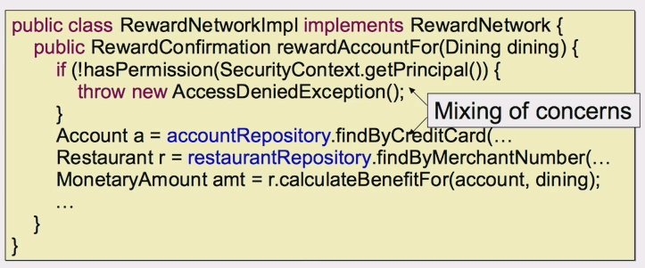
Implementing Cross-Cutting Concerns with out Modularization
• Failing to modularize cross cutting concerns leads to two things
1. Code tangling
A coupling of concerns
2. Code scattering
The same concern spread across modules

Slide 44

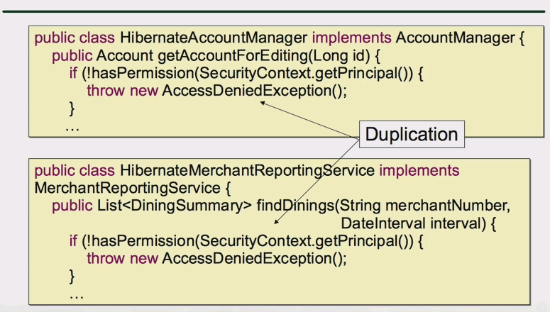
Implementing Cross-Cutting Concerns with out Modularization

Slide 45
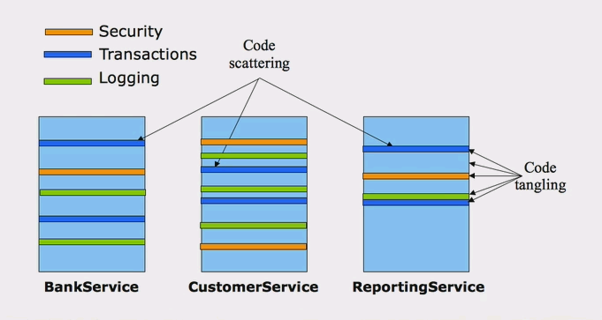
System Evolution Without Modularization

Slide 46
Aspect-Oriented Programming
Aspect oriented programming (AOP) enables modularization of cross-cutting concerns.
- to avoid tangling
- to eliminate scattering
How AOP Works
Implement your mainline application logic
. focusing on the core problem
Write aspects to implement your cross-cutting concerns
    Spring provides many aspects out-of-the-box
Weave the aspects into your application
    Adding the cross-cutting behaviors to the right places

Slide 47
Leading AOP Technology
AspectJ
- original AOP technology
- offers full blown Aspect oriented programming langauge
Spring AOP
. Java based AOP framework with AspectJ Integration.

Slide 48
Core AOP Concepts
Join Point
  A point in the execution of the program such as a method call or field assignment
Point Cut
  An expression that selects one or more Join points. That is Set of join points specifying when an advice should fire, e.g. before calling a certain method on the target object
Advice
  Code to be executed at a particular join point that has been selected by a point cut
Aspect
- Unit of Modularization for a concern or a module that encapsulates point cuts and advice
Weaving
– Assembling aspects to create an advised object (at compile time or runtime
Target
- Original object to which you are applying aspects.
Proxy
- final object (after applying aspects to the target object. )

Slide 49
Spring AOP Jars
• spring-aop.jar
• aopalliance.jar
• aspectjweaver.jar
• cglib.jar

Slide 50
AOP Quick Start
• Consider a basic requirement
Log a message every time a property i.e about to change
• How can you use AOP to meet it?

